Slide 1




Phools for "फूल"
Flowers & Plants E-commerce

Slide 2
Problem Statement :
In today's fast-paced world, customers seek a convenient and reliable platform for purchasing flowers and plants. However, many existing platforms face challenges such as limited variety, high prices, poor quality, and lack of plant care information. The goal is to create a seamless eCommerce experience that offers a wide selection of high-quality products, timely delivery, and helpful care instructions, ensuring satisfaction for plant enthusiasts and gardeners.

Slide 3



Proposed Project Team Members
Paramveer Kansal – 2210990636 Pareen Khirbat – 2210990639 Pari Gupta – 2210990640 Parul Arora - 2210990645
Total Duration of Project
200 Hours

Slide 4
Technical Nodes
01.
02.
03.
04.
Frontend
Backend
Database
Payment Integration
React js
Node js
Express js
MySQL
Razorpay

Slide 5
Foundation:
Our Website was founded with the vision of making flower and plant shopping effortless through a seamless online platform. It offers a wide variety of fresh flowers, potted plants, and custom floral arrangements. With secure payments, real-time stock updates, and reliable delivery tracking, customers can shop with confidence. The platform provides expert plant care tips, gifting options, and subscription services for regular deliveries. With an intuitive interface and smooth checkout process, bringing nature closer to customers while ensuring a delightful shopping experience.

Slide 6
Key Features
01.
03.
05.
User Authentication
Cart & Wishlist
02.
04.
Forgot
Password
User-friendly Interface
Secure Authorization

Slide 7
User Benefits
Convinient Shopping
Variety
Easy
Authentication
Secure & Reliable Platform

Slide 8

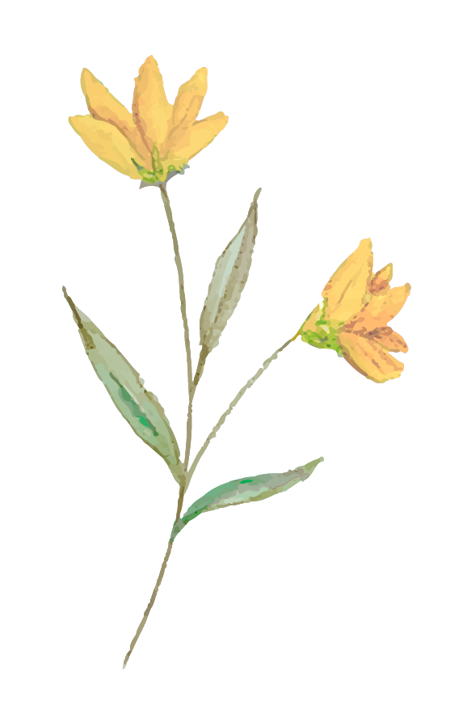
Upcoming Features
Payment Gateway
01.
Order Confirmation
02.
Categorization
03.
A secure and seamless payment integration to facilitate hassle-free transactions.
Automated order confirmation system to notify customers about their purchase details.
Improved product categorization to help customers easily find and select plants or flowers.

Slide 9
Market Competitors
The flowers and plants e-commerce market is highly competitive, with key global players like 1-800-Flowers, ProFlowers, FTD, BloomNation, The Sill, Bloom & Wild, UrbanStems, and Plants.com offering a wide range of floral arrangements and plant deliveries. Regional leaders such as Farmgirl Flowers, Léon & George, MyFlowerTree, Ferns N Petals (FNP), and Interflora provide localized services with unique offerings. Additionally, Amazon, Walmart, and Etsy serve as indirect competitors, selling plants and flowers alongside other products. To stand out, businesses must focus on personalization, plant care services, AI-powered recommendations, and eco-friendly solutions to enhance customer experience and gain a competitive edge.

Slide 10


Thanks!

